Slide 1
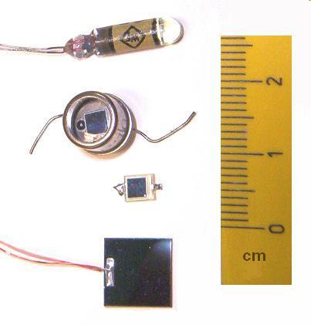
PHOTO DIODE
DR.A.ANBARASI
ASSOCIATE PROFFESSOR IN PHYSICS
PERIYAR ARTS COLLEGE
CUDDALORE.

Slide 2
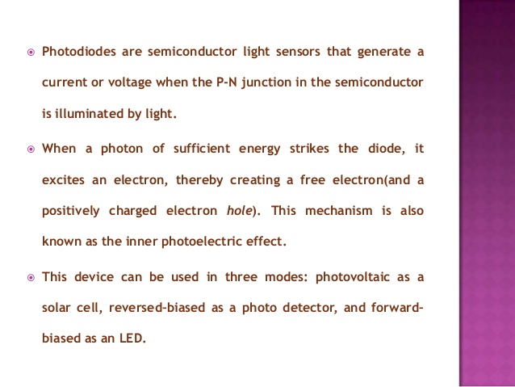
PHOTO DIODES

Slide 3
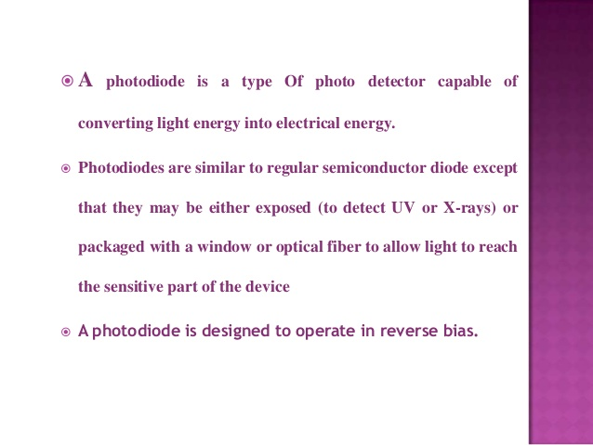
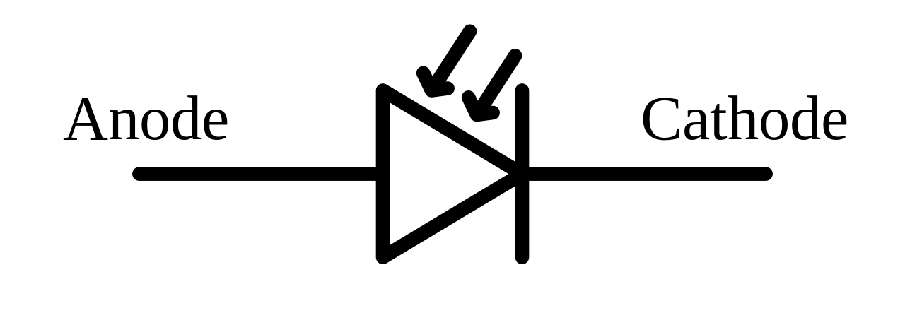
This Photo by Unknown Author is licensed under CC BY-SA

Slide 4
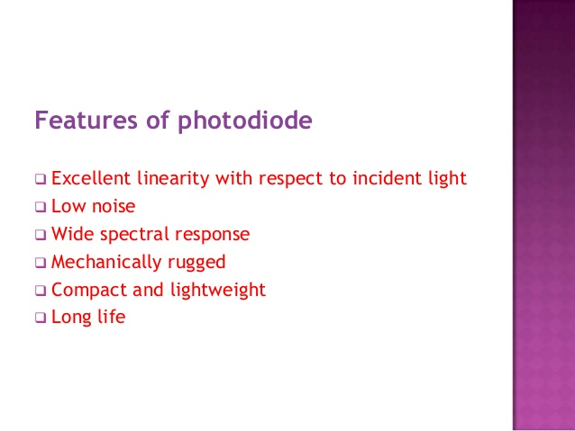

Slide 5
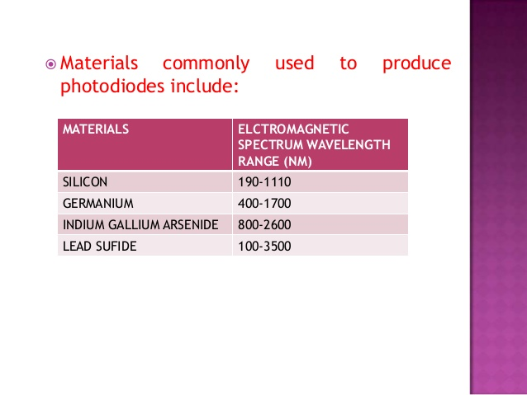

Slide 6
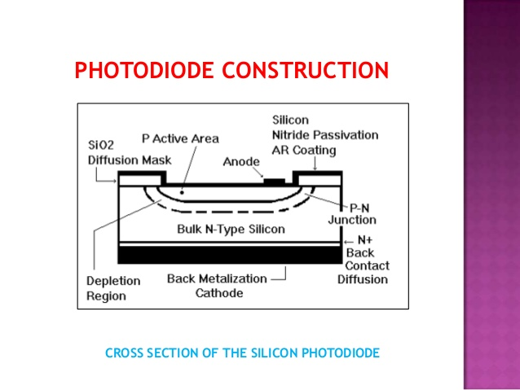

Slide 7
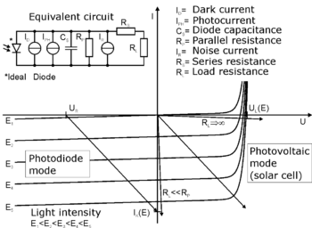

Slide 8
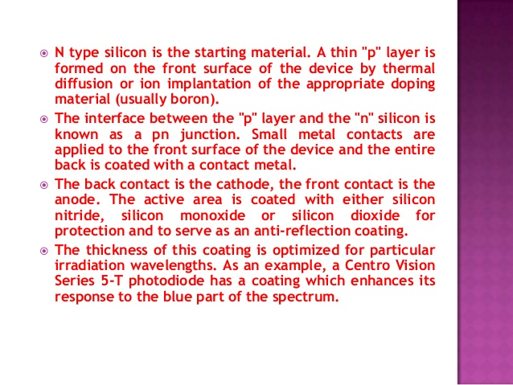

Slide 9
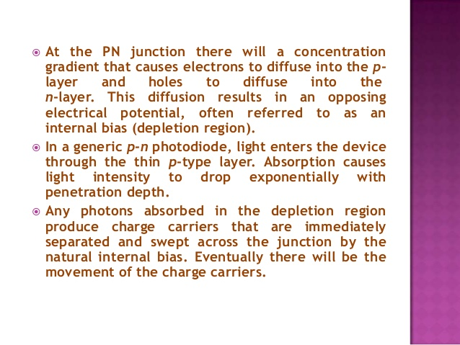

Slide 10
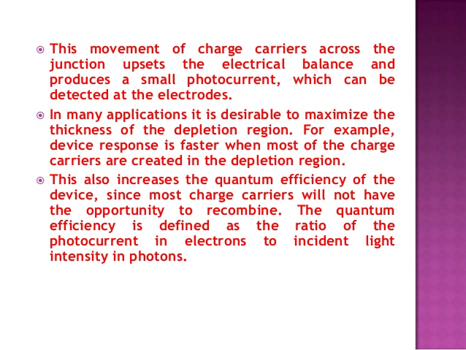

Slide 11
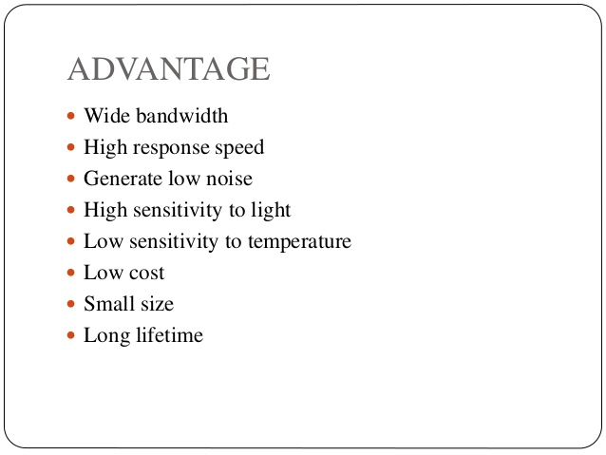

Slide 12
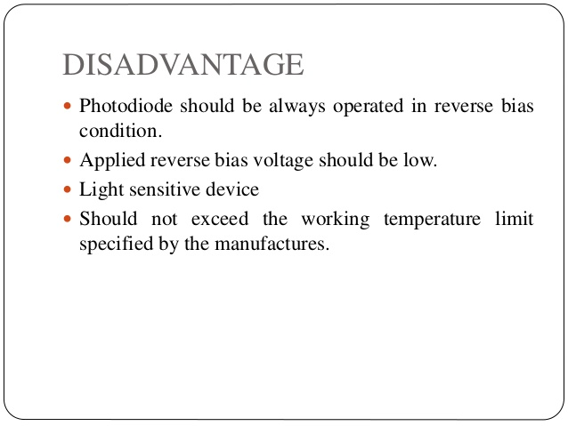

Slide 13
V-I CHARACTERISTICS
Photodiode operates in reverse bias condition. Reverse voltages are plotted along X axis in volts and reverse current are plotted along Y-axis in microampere. Reverse current does not depend on reverse voltage. When there is no light illumination, reverse current will be almost zero. The minimum amount of current present is called as Dark Current. Once when the light illumination increases, reverse current also increases linearly

Slide 14
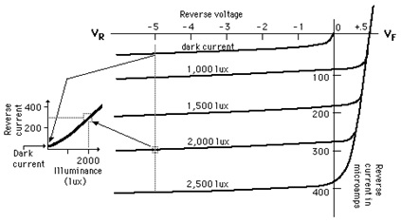

Slide 15
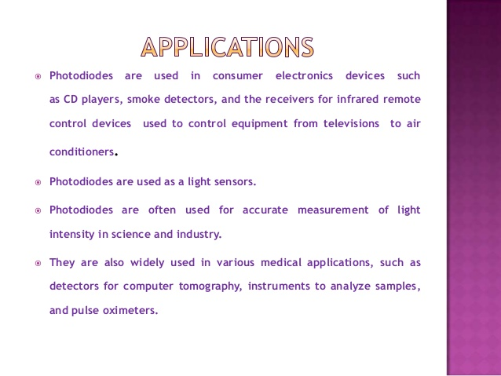

Slide 16


